Slide 1
“Providing Godly financial help, hope, and healing.
Notes:
First Established in 2000, 12 years later God opened the door to begin, this time with Him at the helm of the ship.

Slide 2
Who Agape Source is…
Agape Source Financial is a not-for-profit ministry-first incorporated on 9-20-2000
Operating under the Kearney Area Community Foundation’s 501 (c) 3
Vehicle through which the Body of Christ may work together to free our brothers and sisters in debt-we are here to help strengthen the church not diminish them!

Slide 3
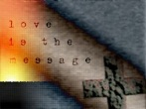
Agape Source Taking Flight
Who Agape Source will serve
How Agape Source will serve
Items needed to Take Flight
Break
Testimony: this service works
Details
Notes:
Serve the Body of Christ that are in financial distress or under hardships. We will serve by offering financial investments, counseling, and Church’s will provide mentoring and accountability.

Slide 4
To help or not to help….

Slide 5
What if……..
http://play.simpletruths.com/movie/pulling-together/
The church was made up of geese?

Slide 6
The end is only the beginning
Matthew 25:31-46
Sick
Hungry
Thirsty
Stranger
Prisoner
Neighbor
Notes:
The Sheep and the Goats
³¹ “When the Son of Man comes in his glory, and all the angels with him, he will sit on his glorious throne. ³² All the nations will be gathered before him, and he will separate the people one from another as a shepherd separates the sheep from the goats. ³³ He will put the sheep on his right and the goats on his left.
³⁴ “Then the King will say to those on his right, ‘Come, you who are blessed by my Father; take your inheritance, the kingdom prepared for you since the creation of the world. ³⁵ For I was hungry and you gave me something to eat, I was thirsty and you gave me something to drink, I was a stranger and you invited me in, ³⁶ I needed clothes and you clothed me, I was sick and you looked after me, I was in prison and you came to visit me.’
³⁷ “Then the righteous will answer him, ‘Lord, when did we see you hungry and feed you, or thirsty and give you something to drink? ³⁸ When did we see you a stranger and invite you in, or needing clothes and clothe you? ³⁹ When did we see you sick or in prison and go to visit you?’
⁴⁰ “The King will reply, ‘Truly I tell you, whatever you did for one of the least of these brothers and sisters of mine, you did for me.’
⁴¹ “Then he will say to those on his left, ‘Depart from me, you who are cursed, into the eternal fire prepared for the devil and his angels. ⁴² For I was hungry and you gave me nothing to eat, I was thirsty and you gave me nothing to drink, ⁴³ I was a stranger and you did not invite me in, I needed clothes and you did not clothe me, I was sick and in prison and you did not look after me.’
⁴⁴ “They also will answer, ‘Lord, when did we see you hungry or thirsty or a stranger or needing clothes or sick or in prison, and did not help you?’
⁴⁵ “He will reply, ‘Truly I tell you, whatever you did not do for one of the least of these, you did not do for me.’
⁴⁶ “Then they will go away to eternal punishment, but the righteous to eternal life. ”

Slide 7
Called to provide help, hope & healing to…
First thing addressed is how we responded to those in need
Do you know someone in need?
Do they have a need greater than you can carry?
Than your church can carry?
Does not fit in the “entitlement programs?”
No government bailouts available-we will be bailing them out
Notes:
Answer:
The Sheep and the Goats
³¹ “When the Son of Man comes in his glory, and all the angels with him, he will sit on his glorious throne. ³² All the nations will be gathered before him, and he will separate the people one from another as a shepherd separates the sheep from the goats. ³³ He will put the sheep on his right and the goats on his left.
³⁴ “Then the King will say to those on his right, ‘Come, you who are blessed by my Father; take your inheritance, the kingdom prepared for you since the creation of the world. ³⁵ For I was hungry and you gave me something to eat, I was thirsty and you gave me something to drink, I was a stranger and you invited me in, ³⁶ I needed clothes and you clothed me, I was sick and you looked after me, I was in prison and you came to visit me.’
³⁷ “Then the righteous will answer him, ‘Lord, when did we see you hungry and feed you, or thirsty and give you something to drink? ³⁸ When did we see you a stranger and invite you in, or needing clothes and clothe you? ³⁹ When did we see you sick or in prison and go to visit you?’
⁴⁰ “The King will reply, ‘Truly I tell you, whatever you did for one of the least of these brothers and sisters of mine, you did for me.’
⁴¹ “Then he will say to those on his left, ‘Depart from me, you who are cursed, into the eternal fire prepared for the devil and his angels. ⁴² For I was hungry and you gave me nothing to eat, I was thirsty and you gave me nothing to drink, ⁴³ I was a stranger and you did not invite me in, I needed clothes and you did not clothe me, I was sick and in prison and you did not look after me.’
⁴⁴ “They also will answer, ‘Lord, when did we see you hungry or thirsty or a stranger or needing clothes or sick or in prison, and did not help you?’
⁴⁵ “He will reply, ‘Truly I tell you, whatever you did not do for one of the least of these, you did not do for me.’
⁴⁶ “Then they will go away to eternal punishment, but the righteous to eternal life. ”

Slide 8
We will provide help, hope & healing by…
Offering financial training, mentoring, and investments to hurting individuals and families
Partner with churches to provide the framework for:
Training members to mentor, coach
Establishing local accountability
Develop a community of love for each other
Benevolence funds to assist those outside of the faith
Be a harbor where the “lost at sea” can find safety
Aid Christian ministry’s in their call to spread the Gospel
Notes:
Churches are to be a place of worship and teaching of God’s word. When churches are having to spend 85% of what they take in on expenses just keeping the church open there is little room for helping others.

Slide 9
Called to provide help, hope & healing through…
Financial investments(help), mentoring(hope), and love(healing) to those..
Feeling hopeless
With no support
Lacking skills
Divorce
Foreclosures
Bankruptcy
Notes:
It is said that marriages are made in heaven but then why most marriages end in divorce. According to US divorce statistics, the rate of divorce in America is very close to the shocking figure of 50%.
Money also poses as one of the biggest causes in the lives of married couples that ultimately result in divorce. Often, money has been the possible cause of disagreement on different issues between people including couples. The love for money is the root of all kinds of evil and it’s definitely the cause of arguments, fights, and court actions.
The number of U.S. homes receiving a foreclosure filing will climb about 20 percent in 2011, reaching a peak for the housing crisis, as unemployment remains high and banks resume seizures after a slowdown, RealtyTrac Inc. said.
Consumer bankruptcies reached roughly 1.53 million for the 2010 calendar year ended Dec. 31, numbers compiled by National Bankruptcy Research Center for ABI concluded. The figure represents a 9% increase from 2009, when approximately 1.41 million consumer filings were recorded.

Slide 10
Called to provide help, hope & healing to...
Churches
Providing a vehicle to reach the Body of Christ in need
Shine the light on the importance of giving to support their church and each other
Build bridges that will channel the Body of Christ to work together, united, under one God
Establish benevolence funds for those outside of the faith
Help pastor’s to lighten their burden
Notes:
Giving to churches went down 1.2 billion dollars in 2010 this was triple the drop in 2009.
Then and Now:Giving by North American churchgoers was higher during the Great Depression (3.3 percent of per capita income in 1933) than it was after a half-century of unprecedented prosperity (2.5 percent in 2004).
According to the 2012 Yearbook of American & Canadian Churches, the almost $29 billion contributed by church members represented a 2.2 percent decrease in terms of per capita giving.
The $1.2 billion decline in 2010 was nearly three times as large as the $431 million in losses reported in 2009, and "provides clear evidence of the impact of the deepening crises in the reporting period," the Yearbook's editor, the Rev. Eileen Lindner, wrote.
1) The number of Christians has declined 12% since 1990, and is now 76%, the lowest percentage in American history. Read more: http://www.foxnews.com/opinion/2009/09/25/bruce-feiler-christians-americans-gone/#ixzz24TgWpjN9
Approximately 80% of the church’s income is utilized on just keeping the church going. This leaves very little for missions, benevolence, and aid to the ones the Lord has called us to help.

Slide 11
Called to provide help, hope & healing to...
Body of Christ
Free up money that is being paid in interest
Reduce bankruptcy/foreclosures
Restore/refresh families and relationships
Establish a “new-normal” for our wants and desires
Experience freedom from the chains of debt
Open opportunities for ministry close to home
Notes:
Top 3 Largest National Christian Populations:
US - 246,780,000 (79.5% of the Population) Brazil - 175,770,000 (90.2% of the Population) Mexico - 107,780,000 (95% of the Population) Pew Forum on Religion and Public Life (2010)

Slide 12
What if………
There stood the cross,
Burdened with my dross,
And it demanded to be paid
For the mistakes that I made
And Jesus had walked away?
Notes:
Would not to have washed Judas’s feet, or worse yet, receive the Judas kiss. Jesus was fully man however, he was also fully God, God is love, so that kiss must have hurt him deeply, one he came to save was selling for thirty pieces of silver.

Slide 13
He didn’t
We all, like sheep, have gone astray, each of us has turned to our own way; and the Lord has laid on him the iniquity of us all.-Isaiah 53:6

Slide 14
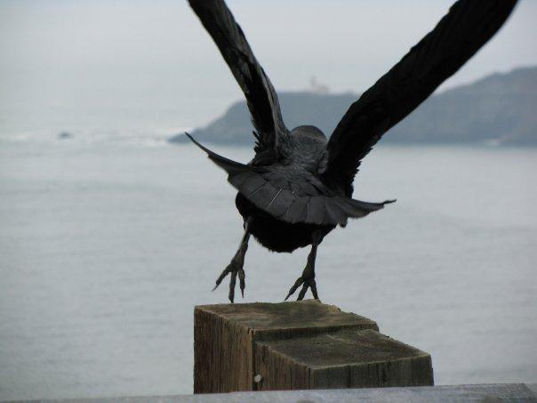
In order to Take Flight….
Partners
Churches
Individuals
Partnership Activities
Financial Mentors
Financial Investors
Professional Advisor’s
Volunteers
Dedicated Board Members
We need you!
Please-during break give your name to someone else and you take theirs. Thank you!

Slide 15
http://www.biblegateway.com/audio/mclean/niv/Isa.58.1-Isa.58.12
Our foundation
Isaiah 58:1-14
Then your light will break forth like the dawn, and your healing will quickly appear; then your righteousness will go before you, and the glory of the Lord will be your rear guard.
Notes:
I was working with someone on how to build this presentation. One thing that was brought up is that you need to address, “death threats’ , what would kill this ministry. Honestly, the only thing I can think of is the very foundation the Lord had given me on 12-7-2000 for Agape to stand on, and still do today, cold hearts and lack of love.

Slide 16
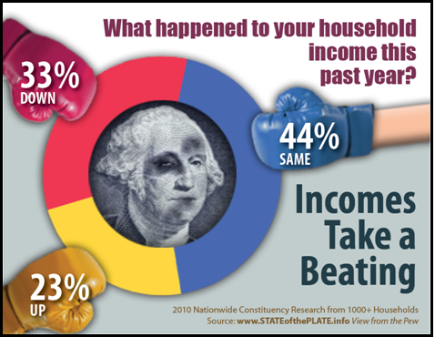
Out of every 1,000 Christians
230 had income go up
440 had income stay the same
330 had their income go down
That means 77% either flat-lined or declined
Which category do you fit in?
Notes:
Many believed their income would increase from year to year, this proved to not be the case.
http://www.generousgiving.org/stats#
: American evangelicals gave four times as much, per person, to churches as did all other church donors in 2001. Eighty-eight percent of evangelicals and 73 percent of all Protestants donated to churches.¹
Among evangelicals, almost 90 cents of every donated dollar goes to their churches. The proportion drops, however, as people's spiritual intensity and commitment to Christ decline.²
Forty percent of church members say they overspend monthly; also, 40 percent of church members pay more than $2,000 a year in interest, not including their mortgage.³
Then and Now:Giving by North American churchgoers was higher during the Great Depression (3.3 percent of per capita income in 1933) than it was after a half-century of unprecedented prosperity (2.5 percent in 2004).

Slide 17
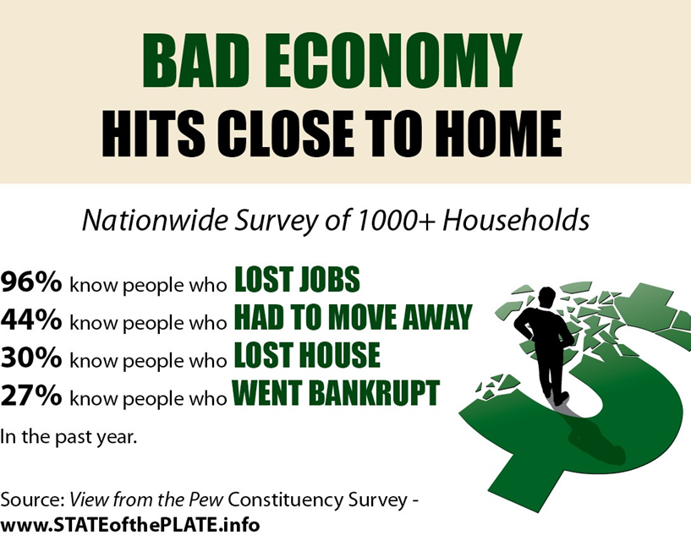
What is the current picture?
96% know people who have lost their jobs
44% know someone who had to move for employment
30% know someone who has lost their home in foreclosure
27% know someone who went bankrupt
Who do you know? Your neighbor, your friend, possibly you?
Notes:
Now we have just looked a small amount of what has happened in the past few years to our country, to our church, what is the solution. I am not one that likes to focus on the problem, instead I want to find the solution. Let me introduce you to pink…..

Slide 18
Pink Bat
http://play.simpletruths.com/movie/pink-bat/store
Our Pink Bat
Notes:
Well by this time, you either have all thought I have a fetish for pink, or just a little on the odd side. Well let me introduce you to the Pink Bat!

Slide 19
How will this work?
Investments will be taken and gifted to eligible participants
Participant will work with mentor and Agape Source staff to establish goals for debt reduction
Participant will utilize funds for intended purposes only
Participant of Agape Source will attend and give to their own church
Participant will be asked to turn and help others when they are able
Notes:
The Agape gift investment will be written in a check to the participant and the one that participant is indebted to. Participant will have to endorse check and send on to entity that money is owed. This will ensure that monies given will be used for purpose gifted and hold participant accountable as well as make them a part of the process of becoming debt free.

Slide 20
How will this work?
Agape Source will tithe to partner churches for Benevolence funds
Agape Source will train mentor’s and will provide services needed by participant
Agape Source will remain non-denominational except for what is in our “Statement of Faith”
Agape Source will be accountable and transparent to Body of Christ for funds Agape receives
Notes:
The Agape gift investment will be written in a check to the participant and the one that participant is indebted to. Participant will have to endorse check and send on to entity that money is owed. This will ensure that monies given will be used for purpose gifted and hold participant accountable as well as make them a part of the process of becoming debt free.

Slide 21
The world’s pink bat!
Galatians 6:2
Matthew 11:28
Notes:
Galatians 6:2 Carry each other’s burdens, and in this way you will fulfill the law of Christ.
Burdens in the Bible: Galatians 6:2 Being a follower of Christ doesn't just mean having your own spiritual burden lifted from your shoulders by Christ. It means actively seeking out those who need help, and shouldering their burdens with them. Service to others is a critical part of the Christian faith.
Matthew 11:28 Come to me all you who are weary and burdened, and I will give you rest.

Slide 22
Psalm 90:16-17
May your deeds be shown to your servants, your splendor to their children.
May the favor of the Lord our God rest on us; establish the work of our hand for us, yes establish the work of our hands.
Notes:
Psalm 90:16-17
New International Version (NIV)
¹⁶ May your deeds be shown to your servants, your splendor to their children.
¹⁷ May the favor^{[a]} of the Lord our God rest on us; establish the work of our hands for us— yes, establish the work of our hands.

